Slide 1

Optimizing the University of Arkansas Ranch Horse Team Season
Myli Brown, Jordan Shortt, Chance Pickett
April 29, 2025

Slide 2
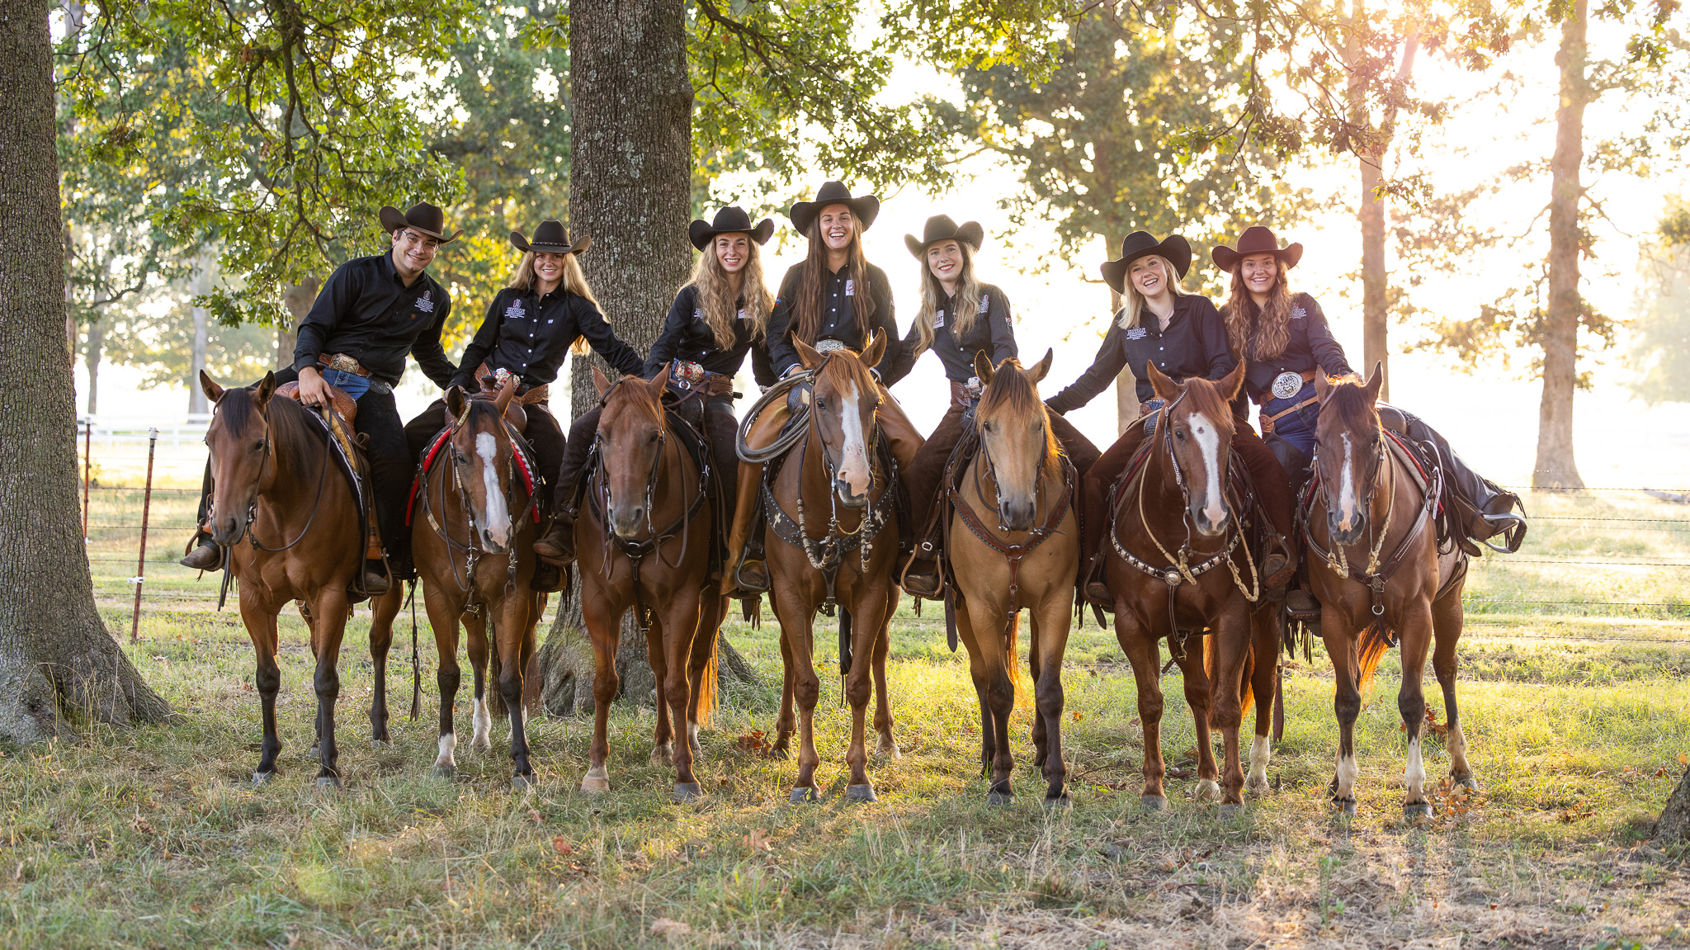

Notes:
Introduce team

Slide 3

The Shows
The team will travel to the following shows:
SHTX – Bryan Bryan, TX
SHTX – World Abilene, TX
NRCHA Ft. Worth, TX
Bridles and Brains Ft. Worth, TX
NIRSHA Amarillo, TX

Slide 4
The Shows
Restrictions:
Both SHTX shows and NIRSHA allow an unlimited number of competitors per team.
NRCHA and Bridles and Brains only allow 3 and 4 competitors respectively.
University policy is that each member of the team must compete in at least two shows per academic year.

Slide 5
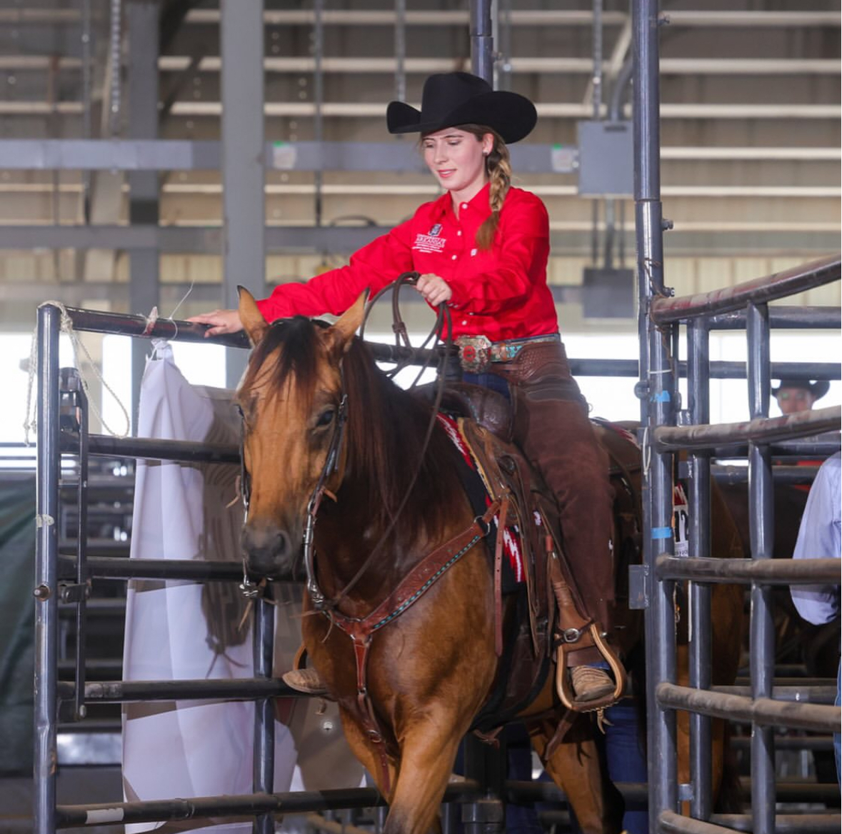
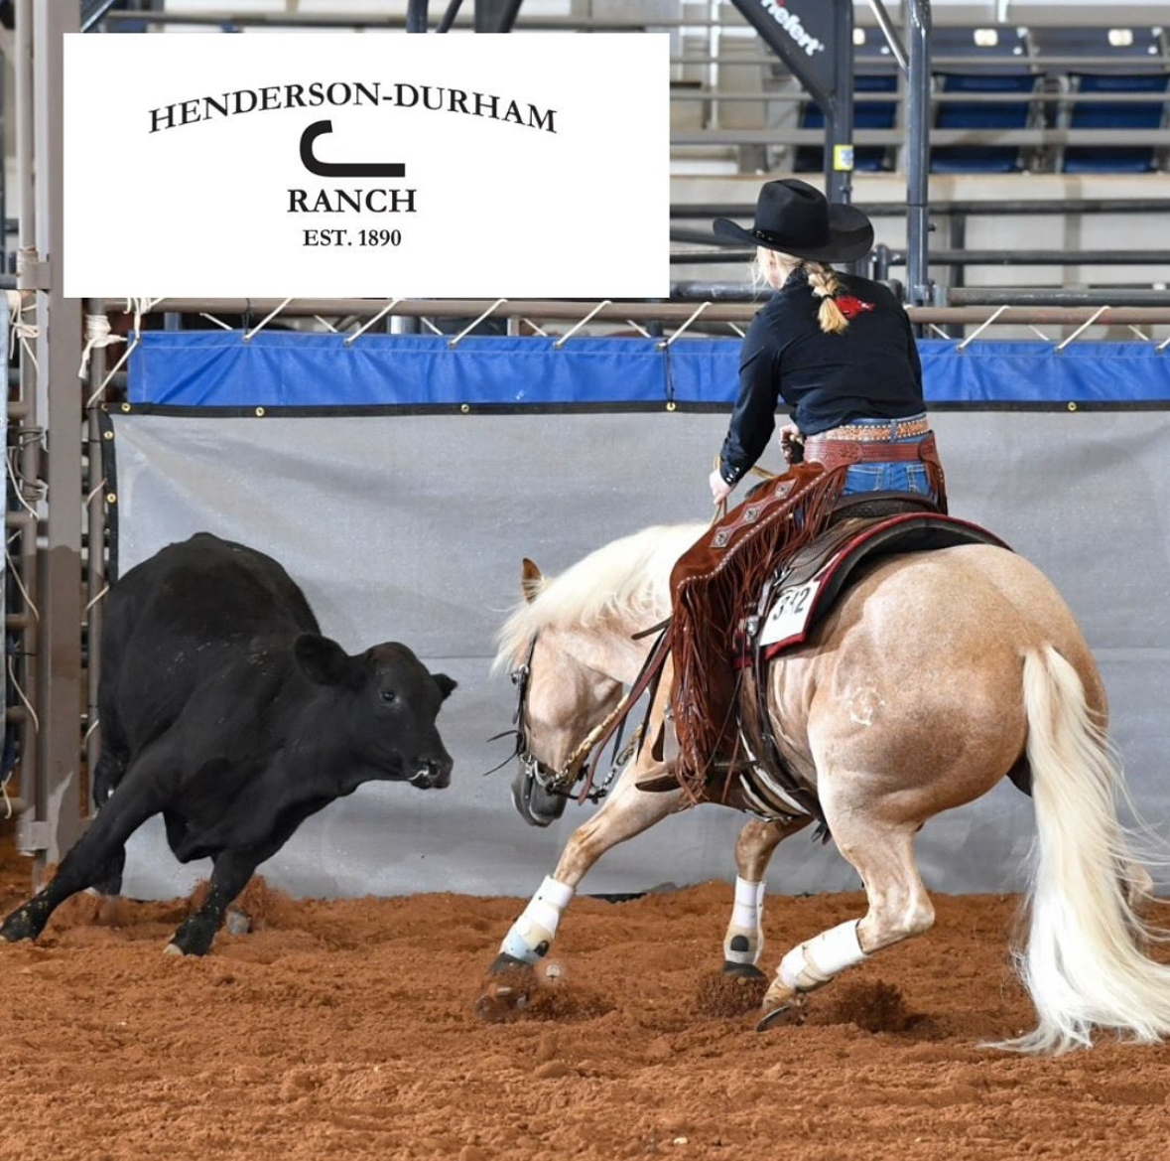
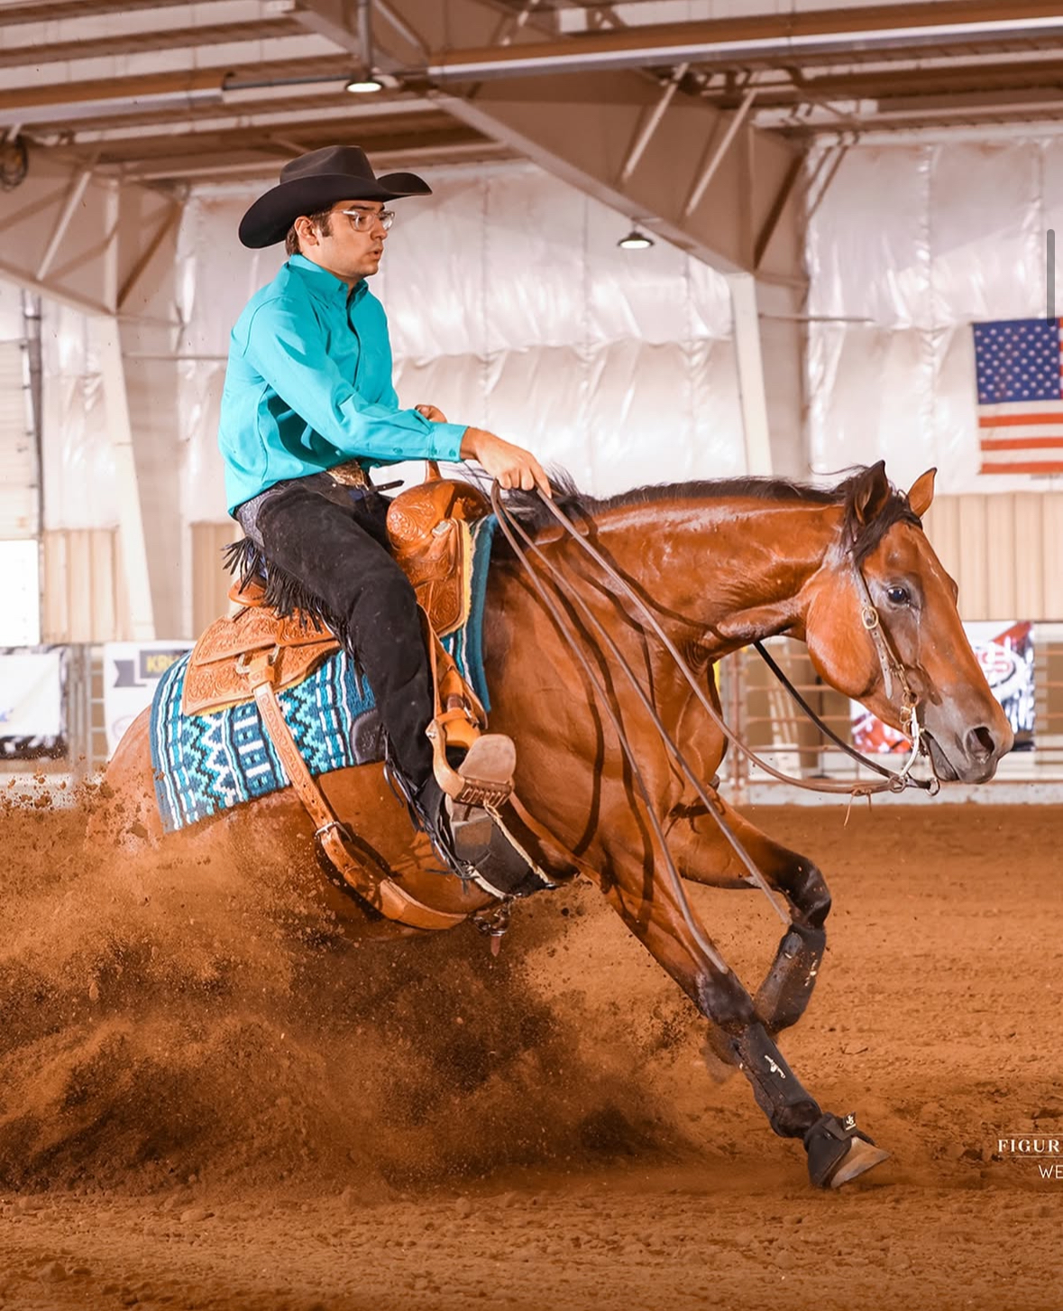
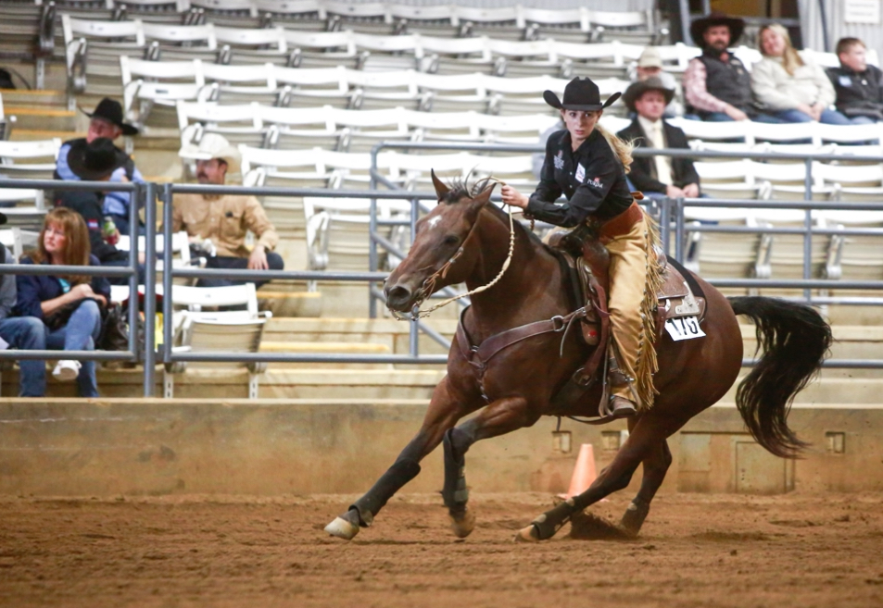
Point Riders
Not every rider's score is counted at shows.
Only the scores of point riders are counted towards the team's end score and determines the team's outcome.
Our optimization model's goal is to pick the best possible combination of point riders for each show.

Slide 6
Scoring
When a horse enters enter the pen it starts with a score of 70.
For each maneuver within the pattern, you will receive a score based on your performance.
The scores of each maneuver and then summed with 70 to create a final score. The higher the end score the better.
Extremely Below | Below | Slightly Below | Average | Slightly Above | Above | Extremely Above
-1 1/2 | -1 | -1/2 | 0 | +1/2 | +1 | +1 1/2
Bad Score | Average Score | Good Score
< 70 | 70 | > 70

Slide 7
Data Collection
There’s a point rider on our team!
Google Maps
Hotels.com
Bing.com AI
Generalizing
7

Slide 8
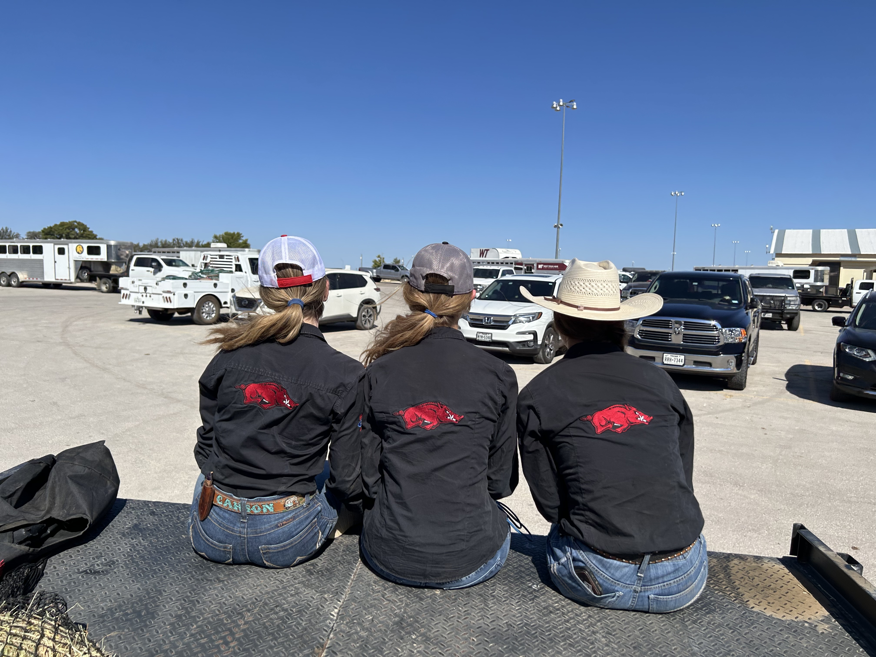
Setting up the Model:
6 team members, 5 shows
$30,000 budget
(Each team member raises $5,000)
Success depends on how often you can send the best combination of point riders to shows without going over the budget
All while allowing lower scoring riders to reach attendance constraints

Slide 9
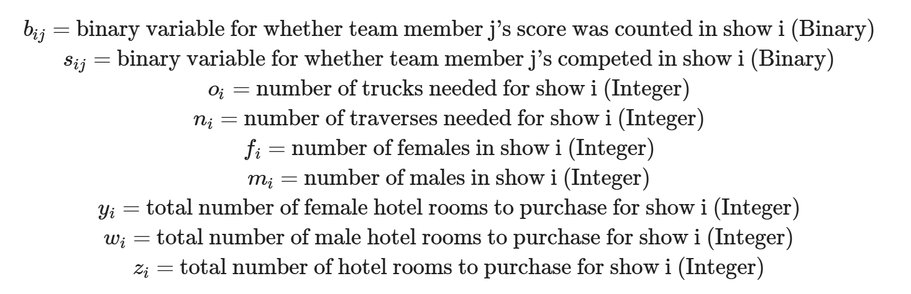
Decision Variables:

Slide 10
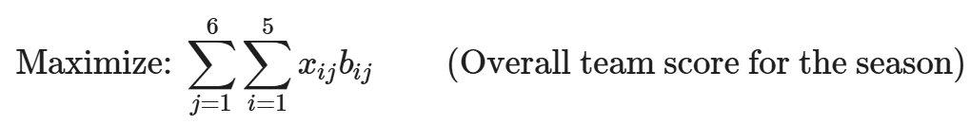

The Model: (Integer Linear Programming Model)
Binary Decision variable:
1 if rider j was a point rider in show i
0 otherwise
Sum over each of the 6 members
Sum over each of the 5 shows
Parameter for the score of rider j in show i

Slide 11

Cost Constraint:
Vehicle Costs
For each show: multiply the number of vehicles (o = trucks & n = traverses) by the
Cost of renting the vehicle
(ro = truck, rn = traverse)
plus the distance traveled divided by miles per gallon for each vehicle type (do = truck, dn = traverse)
Max budget for the season
Hotel Cost
For each show: Cost of a single hotel room, by the number of nights, and by the number of hotel rooms
Show Entry Fee
For each show: multiply the entry fee (per person) by the number of riders attending
Horse Stalling Fee
For each show: multiply the stalling fee (per horse) by the
number of riders attending

Slide 12
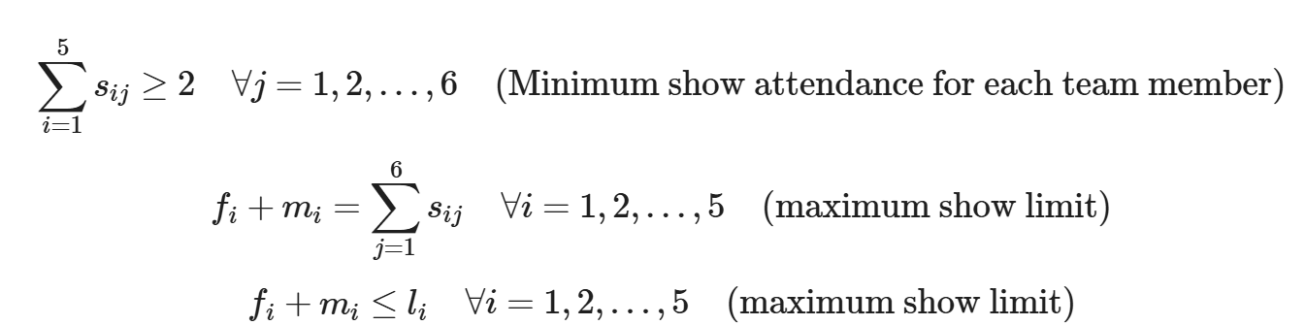
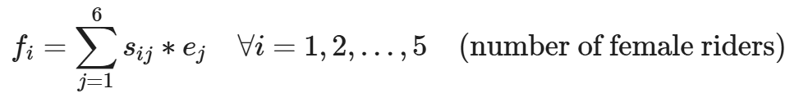
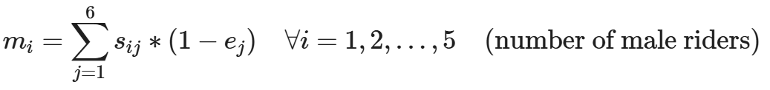
Attendance Constraints:
s is a binary decision variable for whether rider j attended show I (1 = yes, 0 = no)
e is a binary parameter representing the gender of rider j (1 = female, 0 = male)

Slide 13
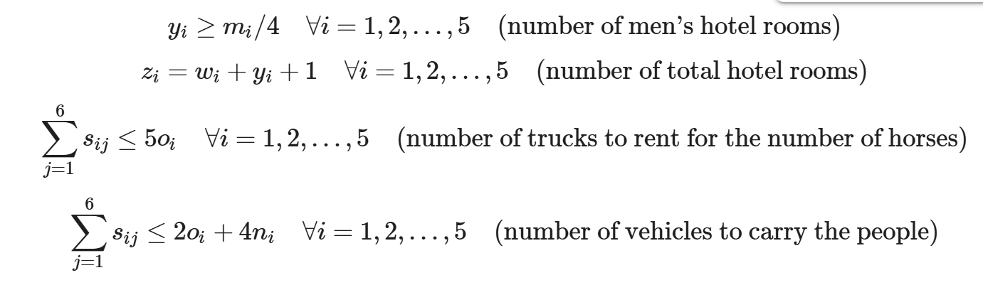
Travel Constraints:
Summary:
A hotel room can have up to 4 riders of the same gender.
The coach needs 1 hotel room.
A truck can hold 5 horses and 2 people.
A traverse can hold 0 horses and 4 people.

Slide 14
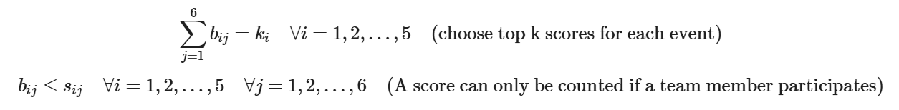
Scoring Constraints:
k represents the number of point riders for show i
b is the number of point riders for the show
s is the number of total riders attending a show

Slide 15
What 's the Solution?
SHTX – Bryan
Point Riders: Jordan, Justine, Kate, Morgan
Non-Point: Carson
SHTX – World
Point Riders: Jordan, Justine, Kate, Morgan
Non-Point: Alex
Bridles and Brains
Point Riders: Jordan, Justine, Kate, Carson
NRCHA
Point Riders: Jordan, Justine, Kate
NIRSHA
Point Riders: Jordan, Justine, Kate, Morgan
Non-Point: Alex
With these point riders, the team should end the season with approximately 5,163 points
The total costs of travel should be $16,026.03, almost $14,000 under budget

Slide 16

Key Takeaways
1 – Even if we have no budget, the costs of travel is around $16,000
Even when given an unlimited budget, our model reaches the same conclusion. This means the team can either lower their sponsorship requirements or use excess funds for team improvements. However, lowering the budget does lower the total points earned.

Slide 17
Key Takeaways
2 – Getting the most points for the entire season is the same as getting the most points per show
Maximizing points per show is the same as maximizing points per season. It's almost impossible to determine how many points will be required to win a show though, and it is never guaranteed. Therefore, maximizing overall points is the easiest way to predict success for each show.

Slide 18
Key Takeaways
3 – A team of one gender is optimal (if you are focusing on budget)
Because different sexes require different hotel rooms, having everyone on the team be the same gender is most cost efficient. If budget constraints were removed, it would also remove the gender preference.

Slide 19
